Slide 1
SC1015 Mini Project
Video Game Sales
Done by: Lee Rei Ern, Joy (U2321787D),
Yap Kwang Hwee (U2322493F) FDDB Team 10

Slide 2
TABLE OF CONTENTS
01
02
03
04
05
PROBLEM AND MOTIVATION
DATA PREPARATION & EXPLORATORY DATA ANALYSIS
MACHINE LEARNING
COMPARISON OF MODELS
OUTCOME AND INSIGHTS

Slide 3
01
PROBLEM AND MOTIVATION

Slide 4
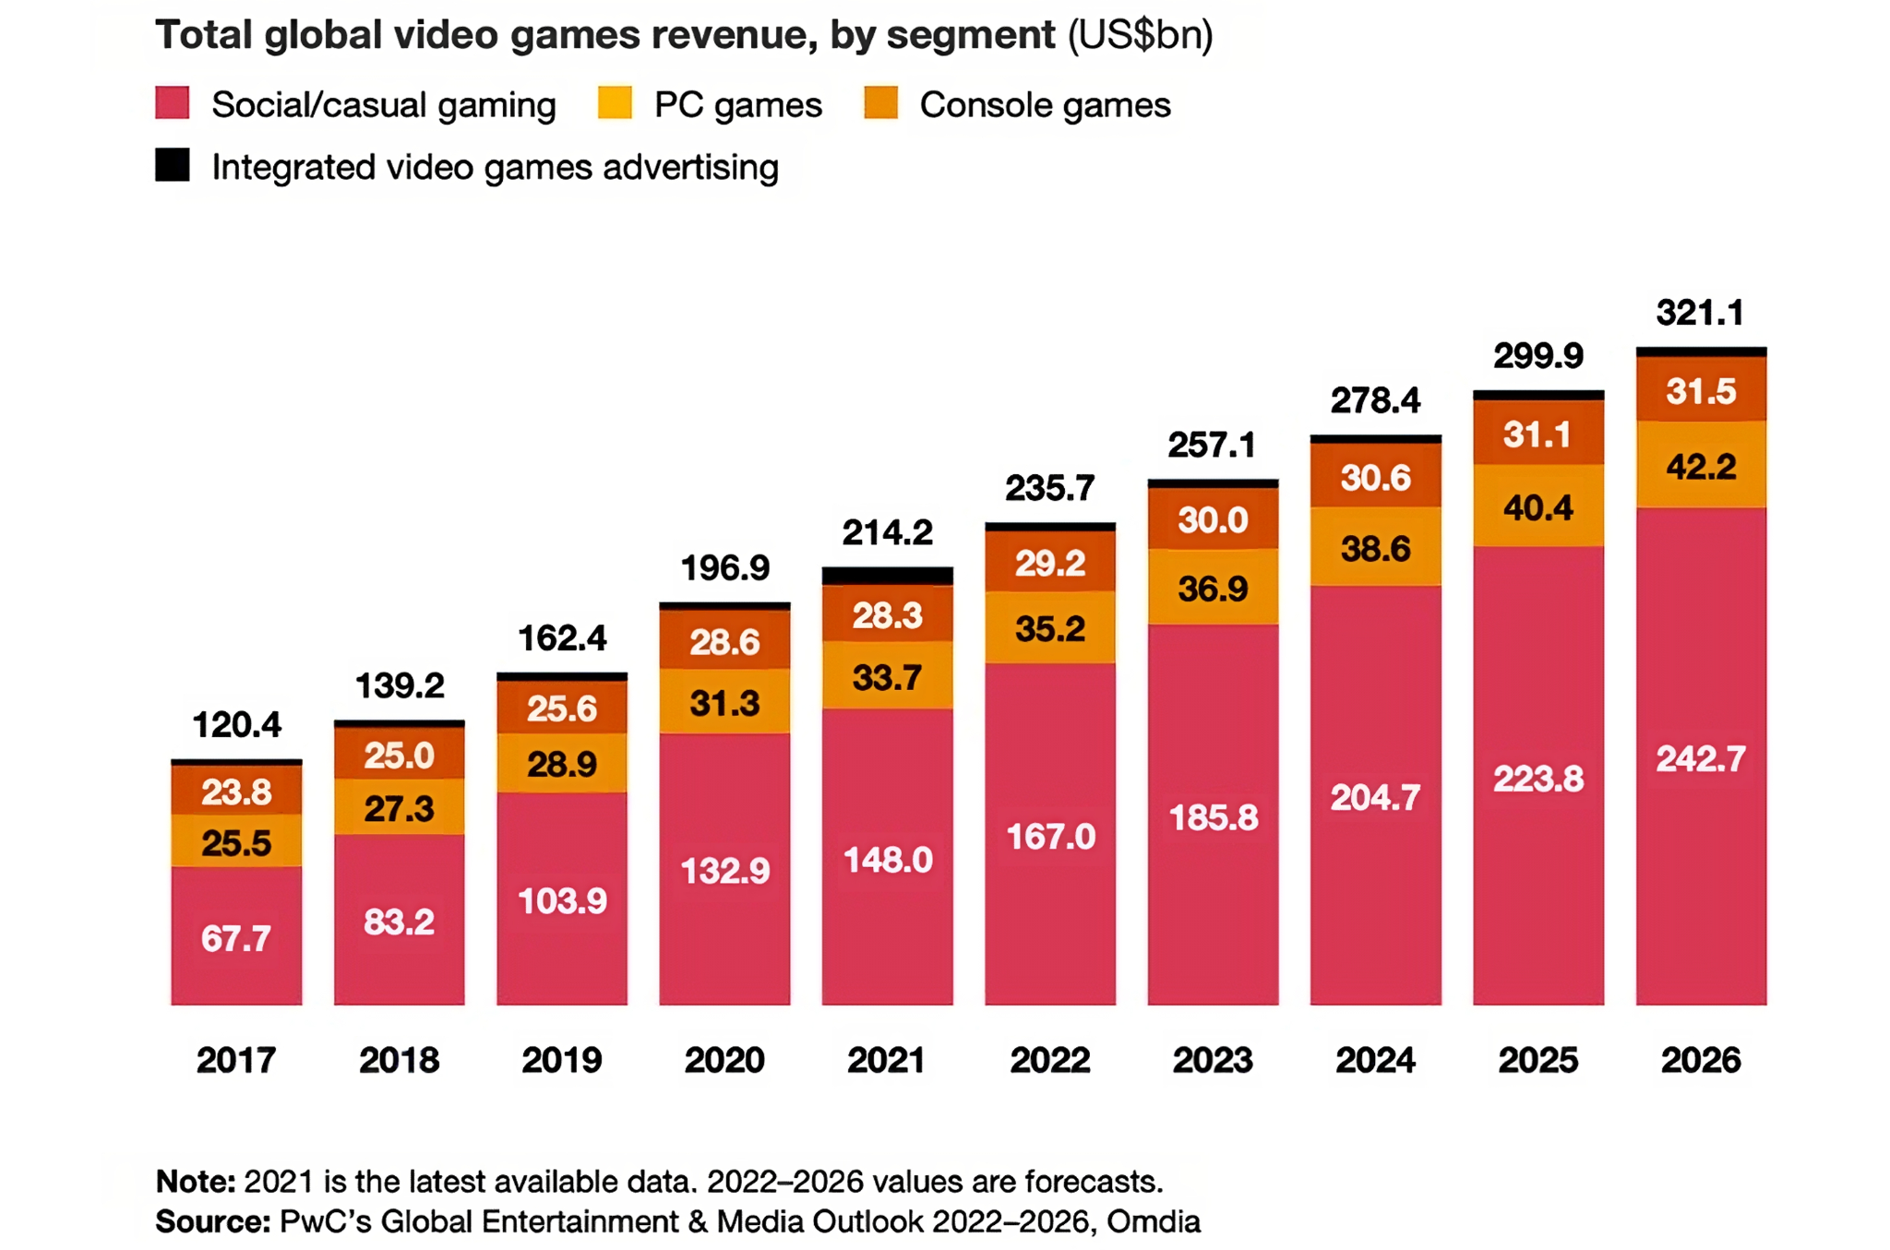
MOTIVATION

Slide 5

MOTIVATION
Global games market generated $184.0B in 2023

Slide 6



MOTIVATION
Rapid growth
Revenue maximisation
Optimise game development

Slide 7
Are certain variables (year, genre, reviews, publisher, etc) able to predict video game sales in different regions?

Slide 8
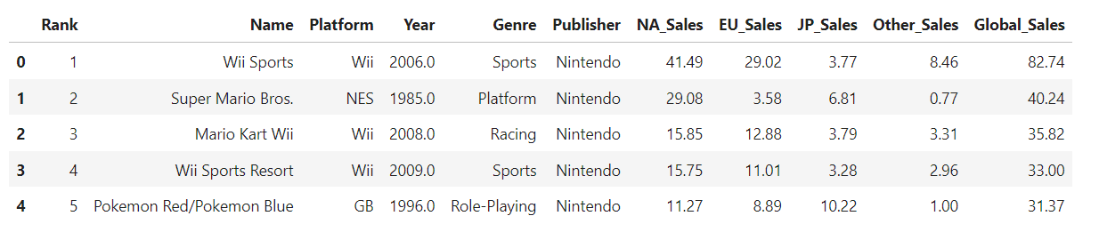
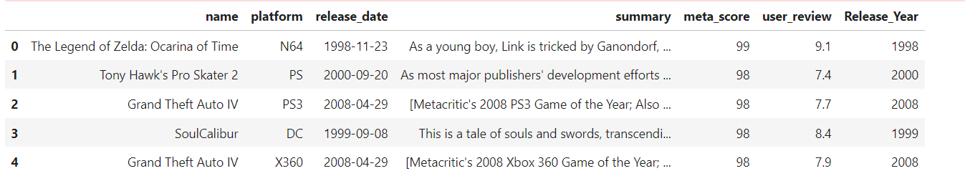
DATASETS USED

Slide 9
02
DATA PREPARATION & EXPLORATORY DATA ANALYSIS

Slide 10
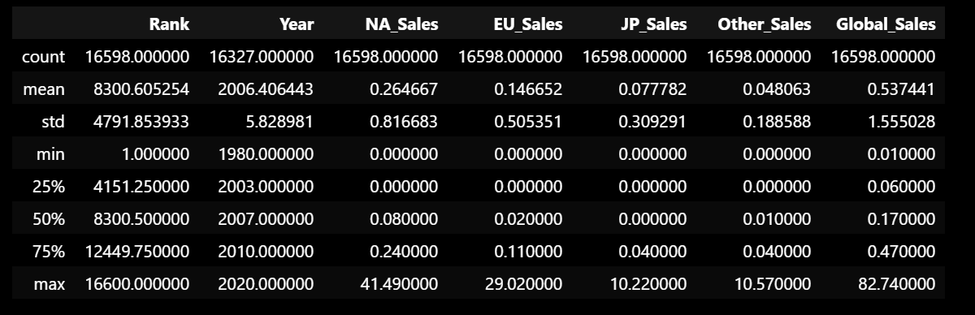
Preliminary Exploration

Slide 11
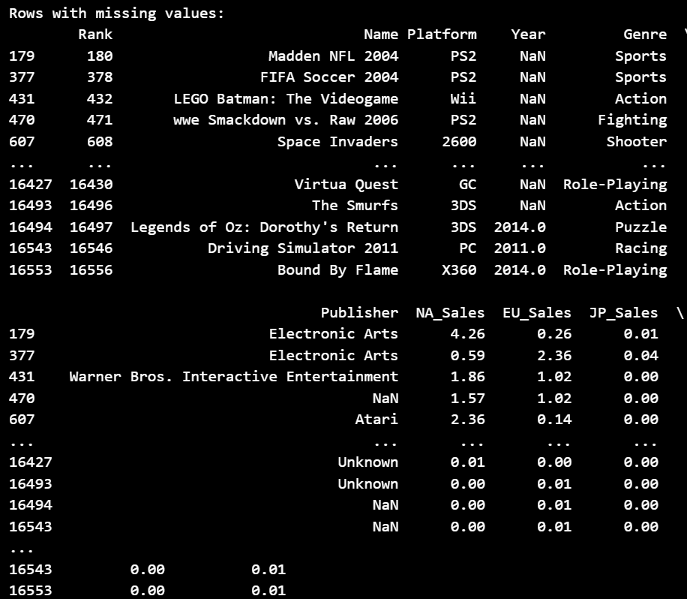
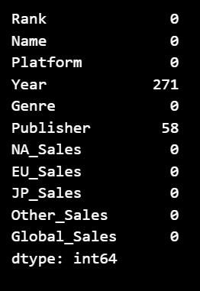
Preliminary Exploration

Slide 12




Data Preparation and Cleaning
Dropped games with ‘tbd’ and dropped Global and Other Sales
Dropped null values
Merge both datasets
Matched columns of both datasets by changing column name
Added missing rows

Slide 13
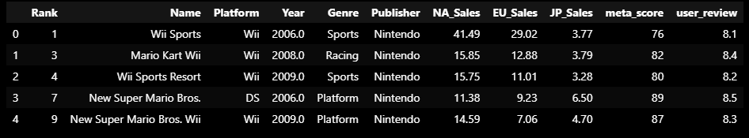
Data Preparation and Cleaning

Slide 14


EXPLORATORY DATA ANALYSIS (EDA)

Slide 15
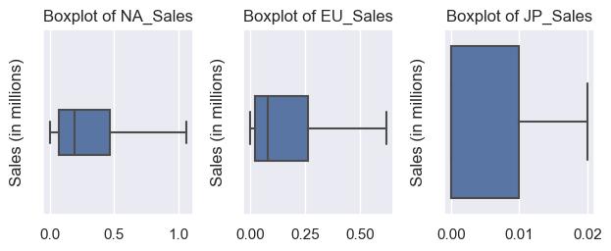
Exploratory Data Analysis

Slide 16
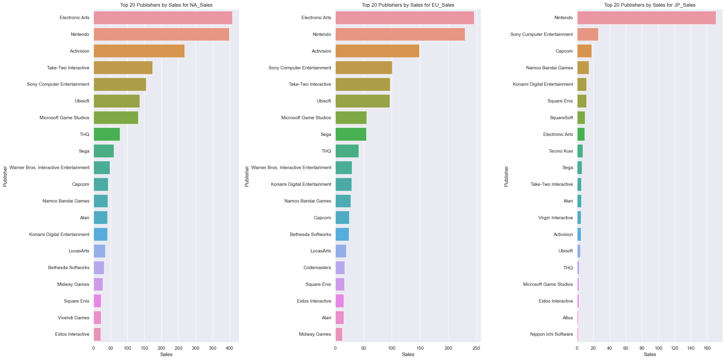
Exploratory Data Analysis

Slide 17
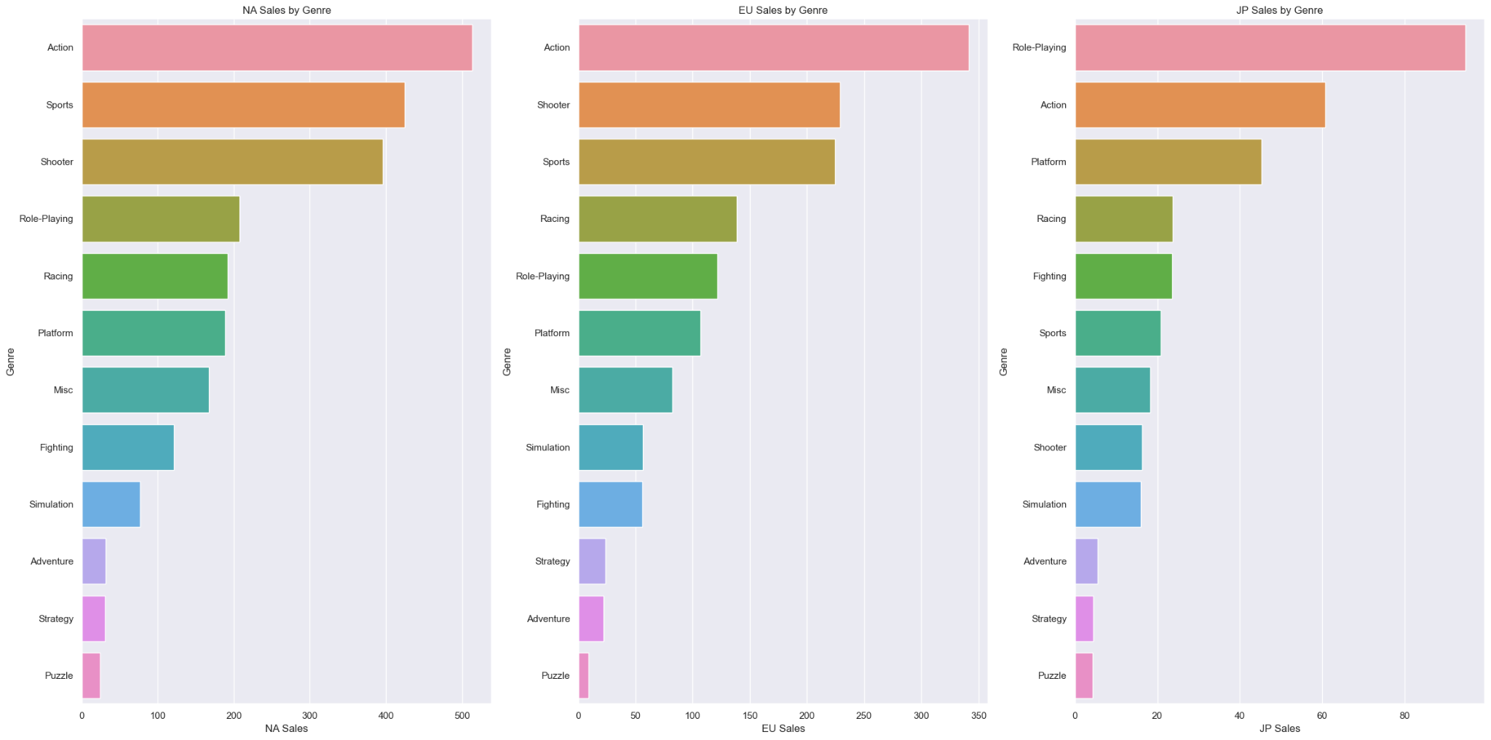
Exploratory Data Analysis

Slide 18
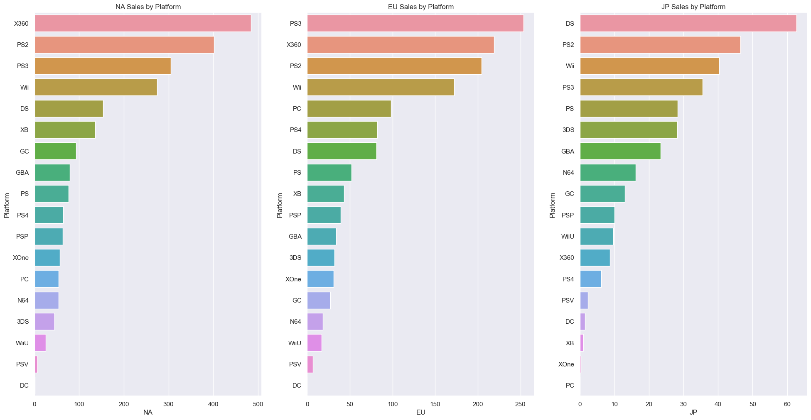
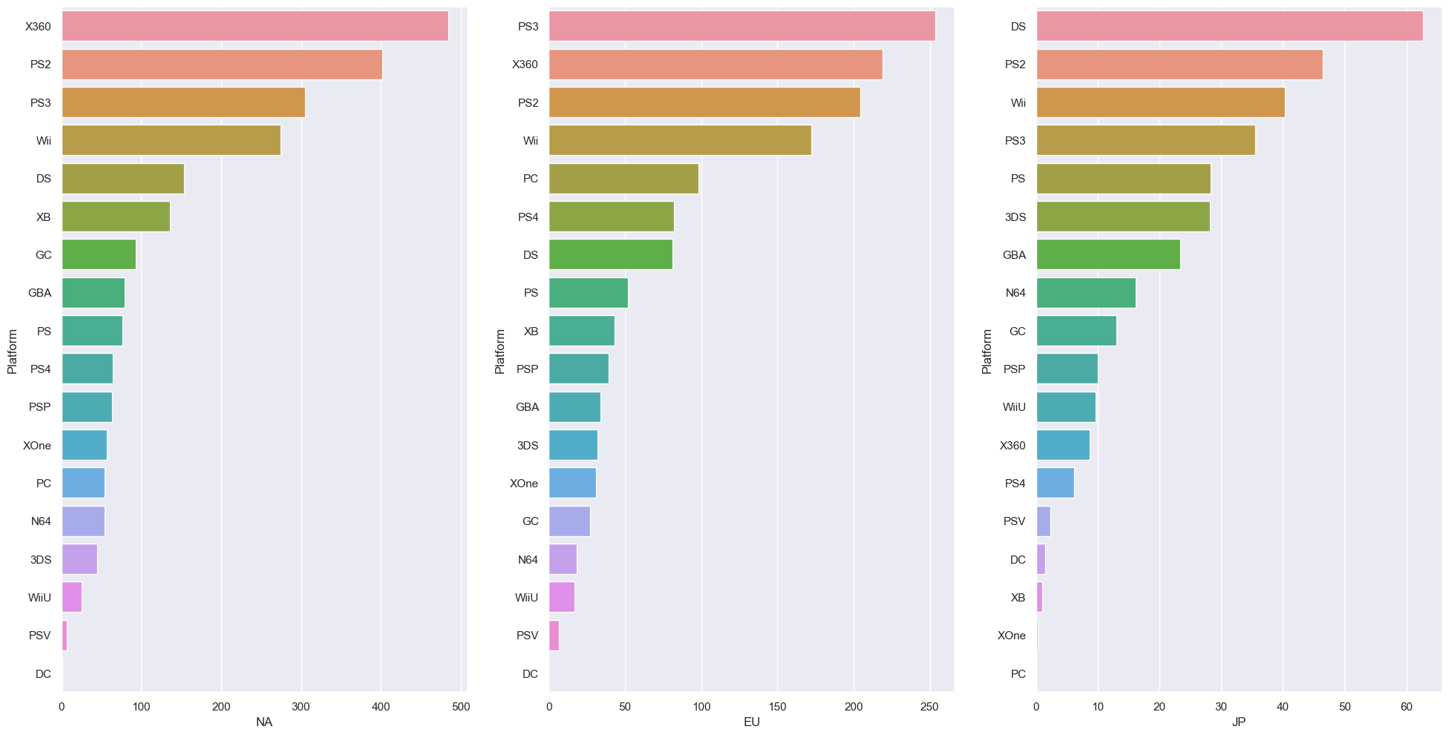
Exploratory Data Analysis

Slide 19
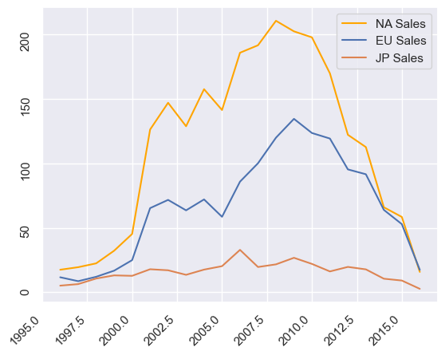
Exploratory Data Analysis

Slide 20
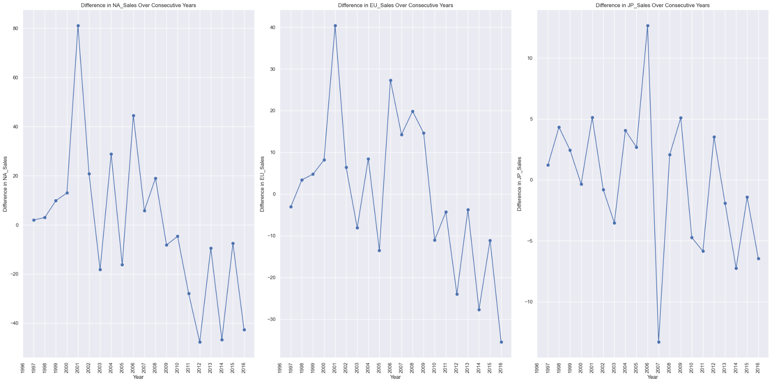
Exploratory Data Analysis

Slide 21
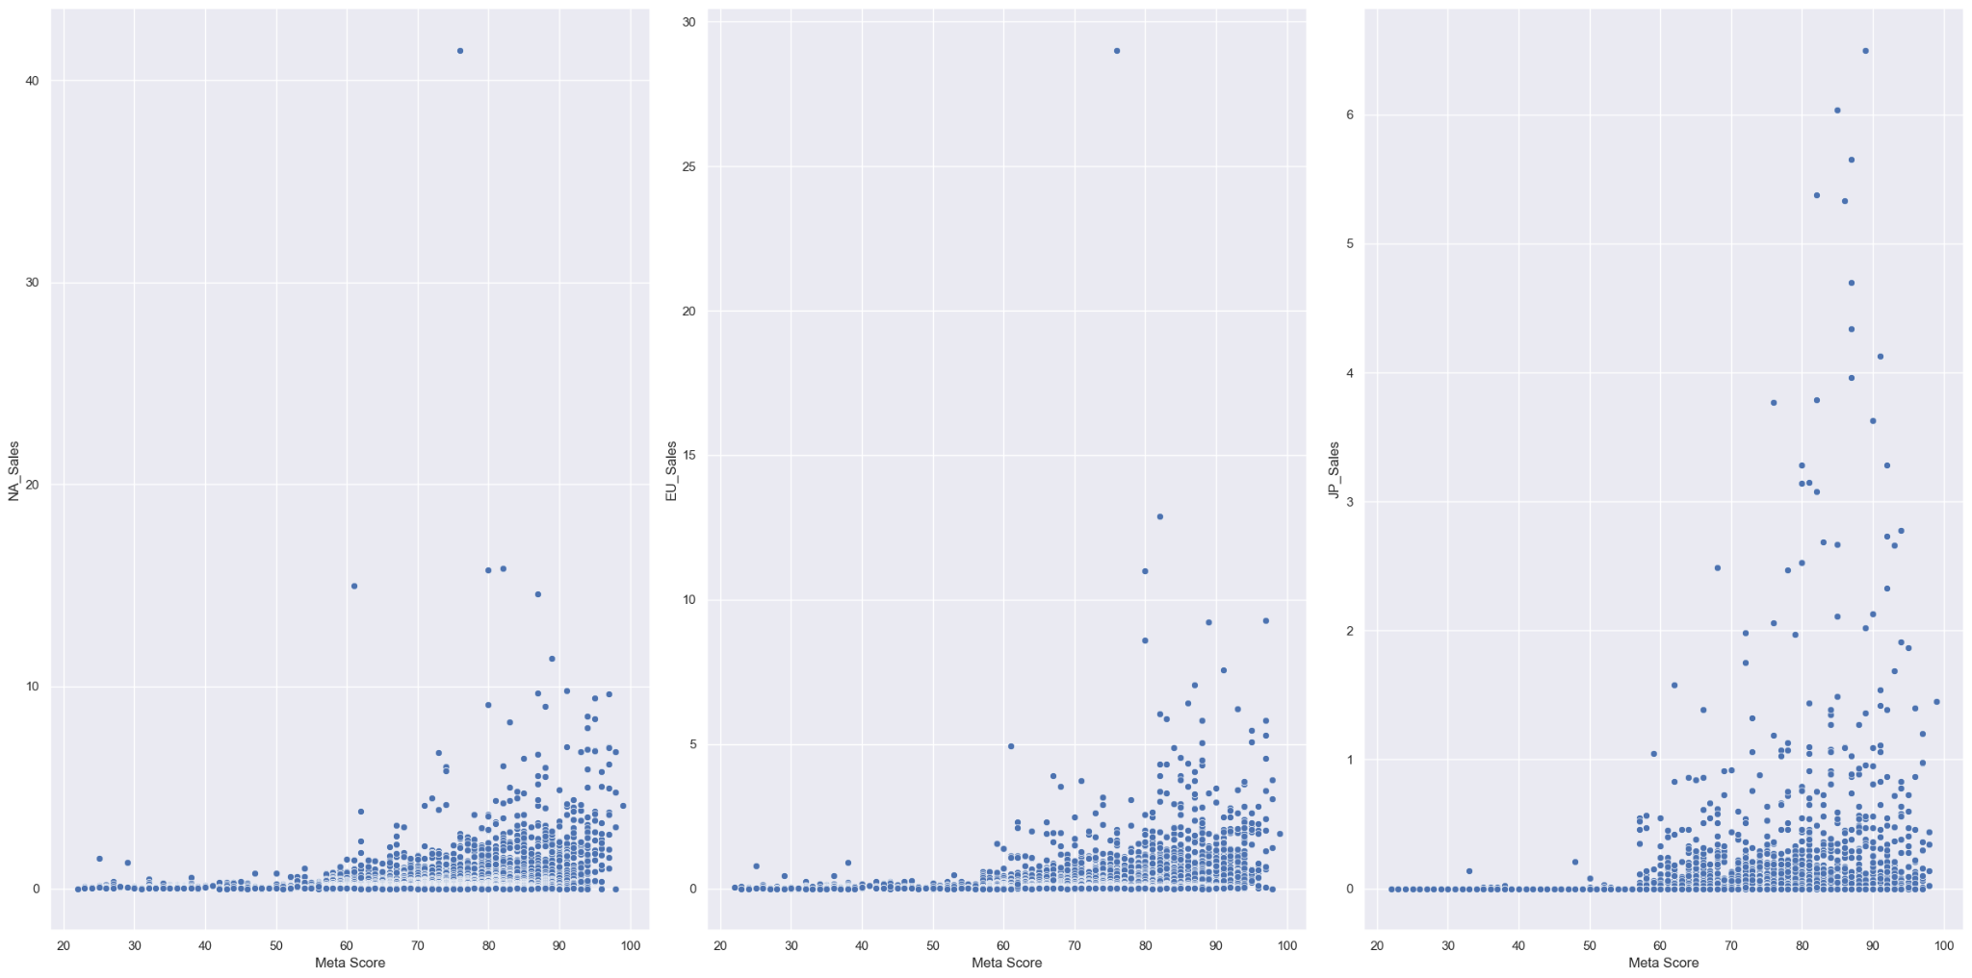
Exploratory Data Analysis

Slide 22
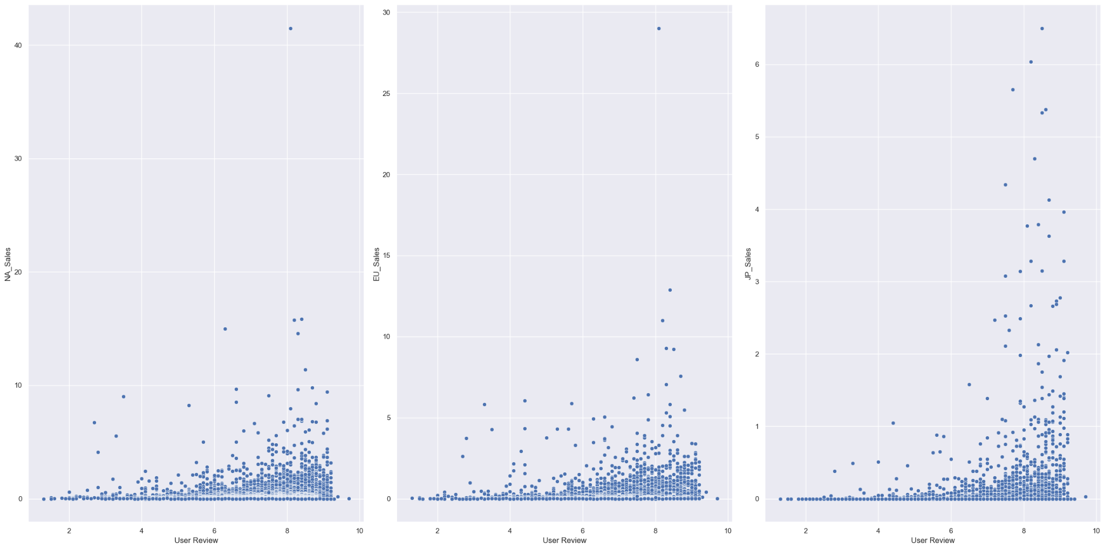
Exploratory Data Analysis

Slide 23
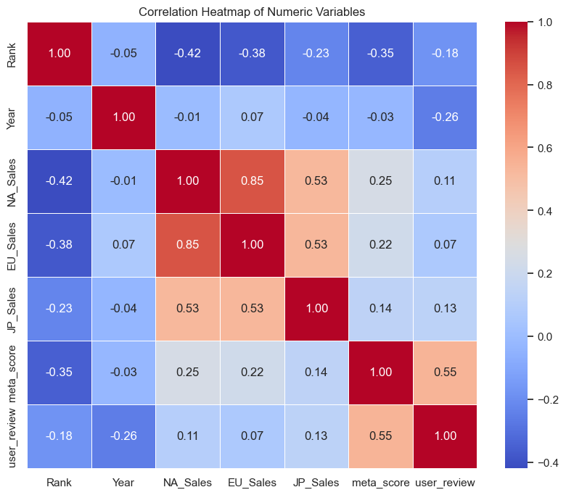
Exploratory Data Analysis

Slide 24

Encoding of Categorical Variables
Method: Target Encoding
Target encoding takes a categorical variable, and compute the mean of the target variable for each of the category, and replaces the category with the target mean.
For example, for the Platform PS4 and NA_Sales, it calculates the mean of NA_Sales for PS4, and replace “PS4” with the number, effectively converting it into numerical.

Slide 25
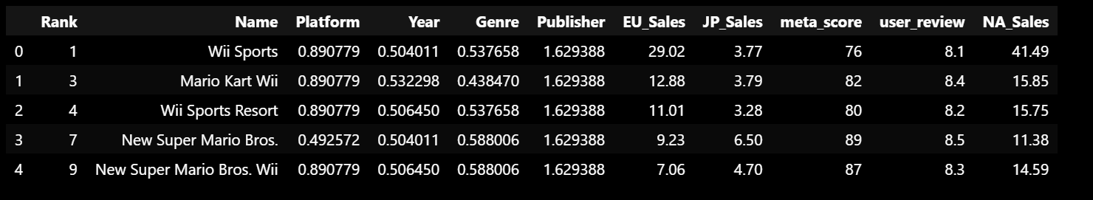
Encoding of Categorical Variables
Data After Encoding (Based on NA Sales)

Slide 26



03
MACHINE LEARNING

Slide 27
Linear Regression (NA)
Linear regression is used to model the linear relationship between all our predictors and response.
Split the dataset into test and train (20:80 ratio)
Train the model using the train set
Apply it to the test set

Slide 28
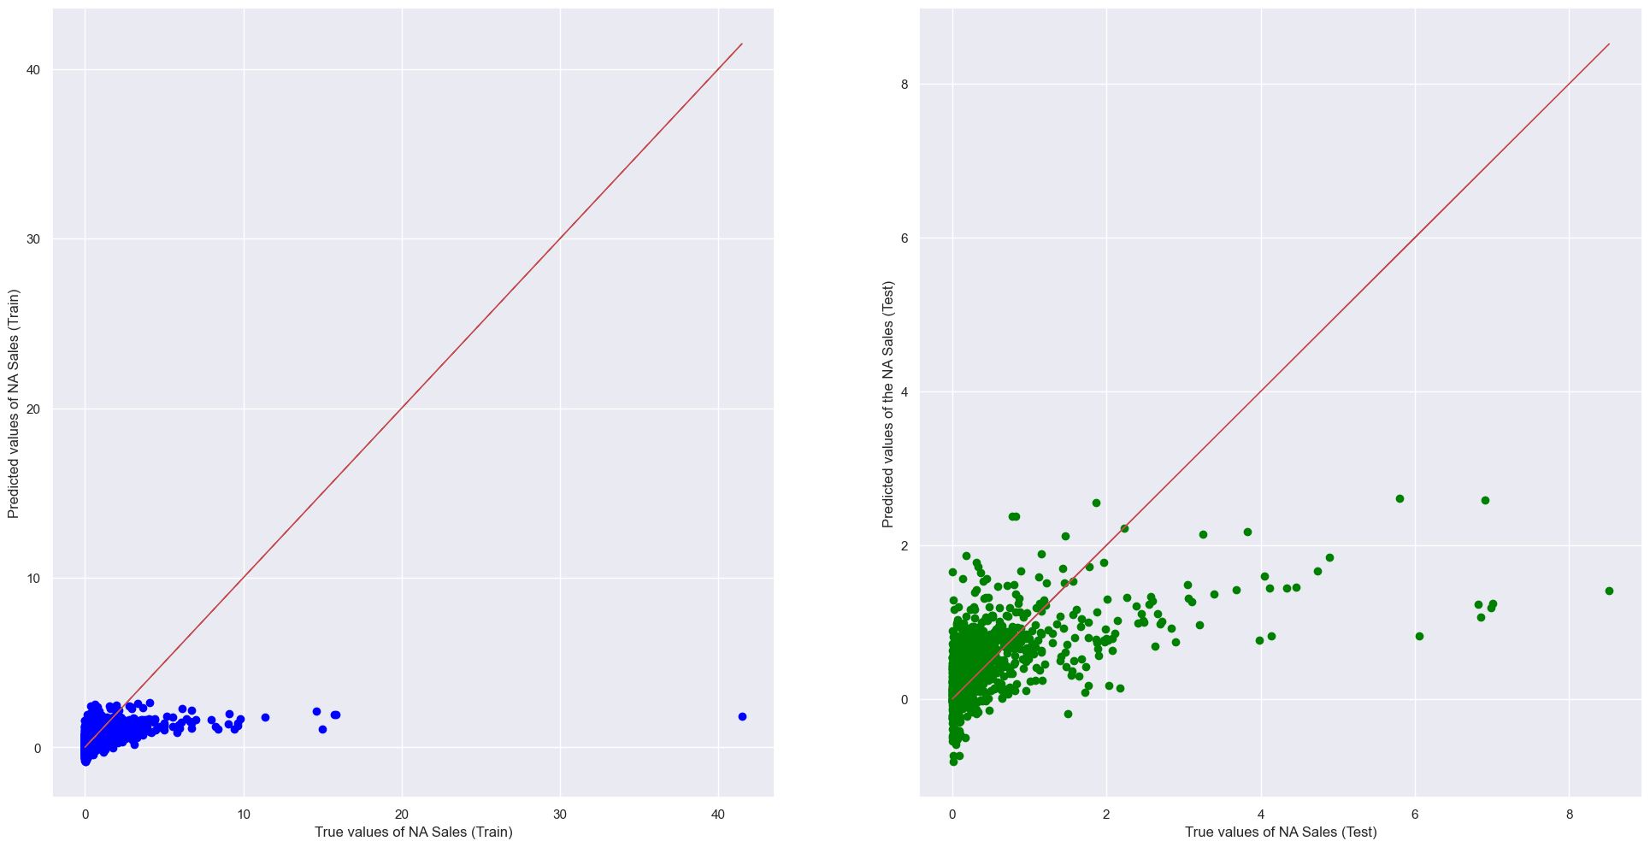
Linear Regression (NA)
Predictors: Platform, Year, Genre, Publisher, meta_score, user_review
Response: NA_Sales

Slide 29
Linear Regression (NA)
Intercept: b = [-2.12110104]
Coefficients: a = [[ 0.86369263 0.40864574 0.5492876 0.84755782 0.02127203 -0.03552594]]
Goodness of Fit of Model (Train Dataset)
Explained Variance (R²) | Mean Squared Error (MSE) | Root Mean Squared Error (RMSE)
0.16119462750292424 | 1.1196241507627174 | 1.0581229374523158
Prediction Accuracy of Model (Test Dataset)
Explained Variance (R²) | Mean Squared Error (MSE) | Root Mean Squared Error (RMSE)
0.28315325368220956 | 0.5576508423170035 | 0.7467602308083924

Slide 30
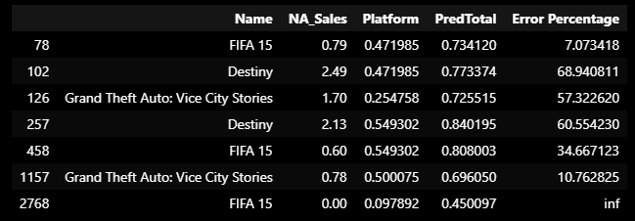
Predictions
Conclusion
This model is not really good at predicting, as the error percentages are quite high.

Slide 31

Random Forest Regression
Random forest combines ensemble learning with decision tree frameworks
Create multiple randomly drawn decision trees
Average results to output strong predictions
Allows us to predict video game sales

Slide 32
Random Forest Regression
Goal: To use an improved model and try to predict the responses with better results
Step 1: Tune
Step 2:
Perform RFR
Step 3:
Feature Importance
Step 4:
Perform RFR again
Step 5:
Compare models

Slide 33
Random Forest Regression (NA)
Step 1: Tuning
Step 2: Random Forest Regression
max_depth:
7
max_features:
sqrt
n_estimators:
200
R^2 Score:
0.6628317497986067
Mean Squared Error (MSE): 0.4312957862361971
Root Mean Squared Error(RMSE):
0.6567311369473791
Out of Bag Score: 0.14016238272014492

Slide 34
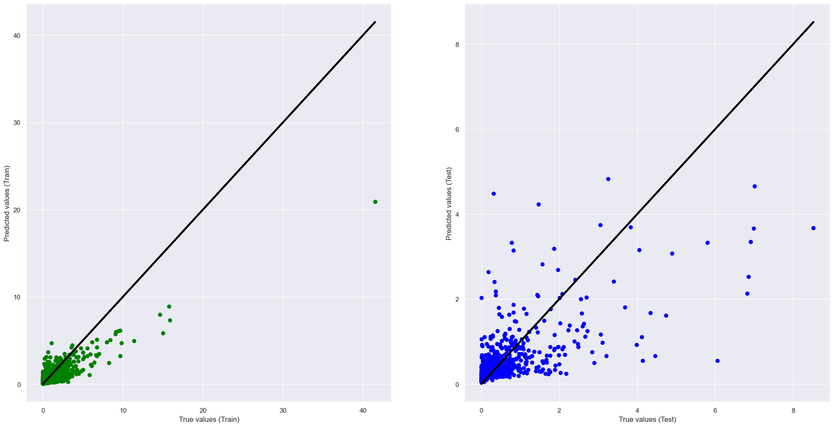
Random Forest Regression (NA)

Slide 35
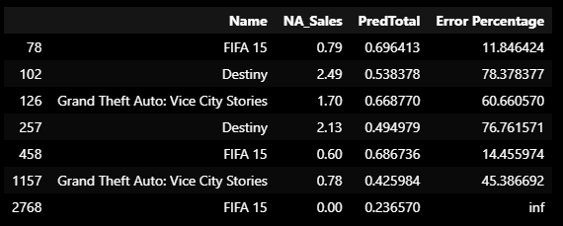
Predictions
Conclusion
The error percentages are still pretty high.

Slide 36
Random Forest Regression (NA)
Step 3: Feature Importance
Step 4: Random Forest Regression
meta_score 0.316076
Publisher 0.177547
Platform 0.144707
user_review 0.141271
Year 0.129743
Genre 0.090656
R^2 Score:
0.6654505569680094
Mean Squared Error (MSE): 0.44624209450150554
Root Mean Squared Error(RMSE):
0.6680135436512538
Out of Bag Score: 0.07696628115699056
Genre is the least significant variable

Slide 37
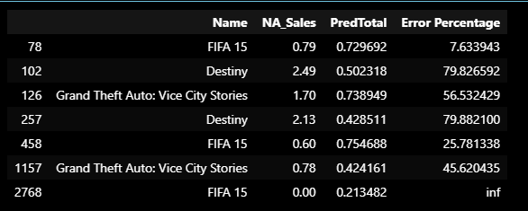
Step 5: Comparison
Including Genre
After removing Genre

Slide 38

XGBOOST
Extreme gradient boosting
Ensemble of decision tree models
Adds one tree to the ensemble at a time and fit
Corrects the prediction errors made by prior models
Predictive modelling

Slide 39
XGBOOST
Tuning
learning rate: 0.02
n_estimators:
200

Slide 40
XGBOOST
Goodness of fit (Train Dataset)
Explained Variance (R²) | Mean Squared Error (MSE) | Root Mean Squared Error (RMSE)
0.8645986125078122 | 0.18073163150080188 | 0.42512543031533867
Prediction Accuracy (Test Dataset)
Explained Variance (R²) | Mean Squared Error (MSE) | Root Mean Squared Error (RMSE)
0.43574256878749007 | 0.4389482597439192 | 0.662531704708476

Slide 41
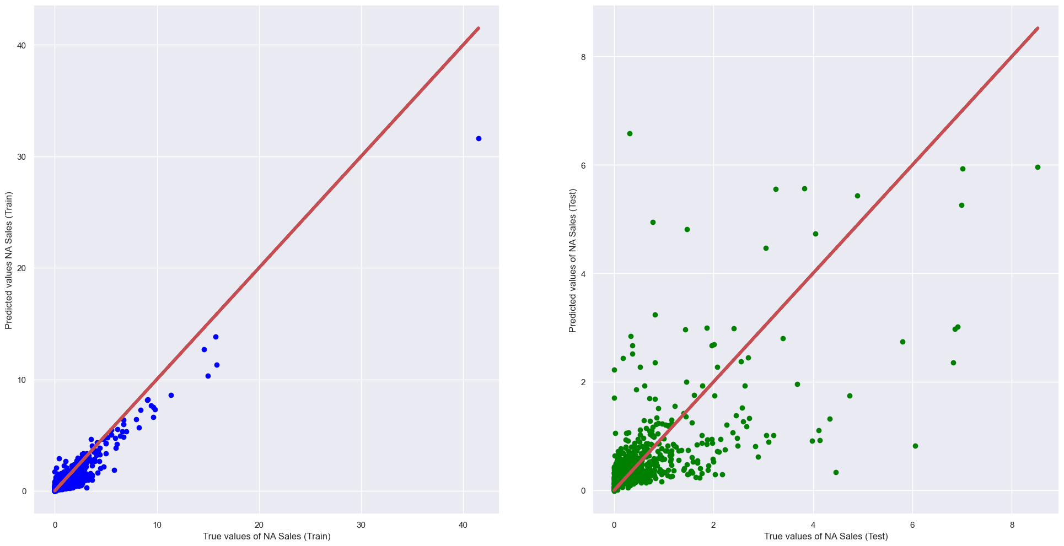
XGBOOST

Slide 42
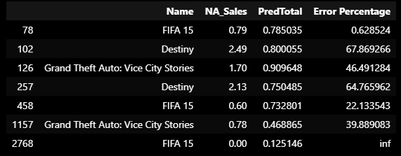
XGBOOST

Slide 43
04
COMPARISON OF MODELS

Slide 44
Comparing Results
 | Linear regression |  |  | Random forest regression |  |  | XGBoost regression
 | NA | EU | JP | NA | EU | JP | NA | EU | JP
MSE | 0.558 | 0.297 | 0.038 | 0.431 | 0.242 | 0.039 | 0.439 | 0.277 | 0.055
RSME | 0.747 | 0.545 | 0.038 | 0.657 | 0.492 | 0.199 | 0.663 | 0.526 | 0.234
R^2 | 0.161 | 0.123 | 0.238 | 0.663 | 0.652 | 0.661 | 0.865 | 0.836 | 0.931

Slide 45


05
OUTCOME AND DATA-DRIVEN INSIGHTS

Slide 46
What we learned:
Random forest regression
Extreme gradient boosting regression
Gridsearch
Outcome of project:
Video game sales can be predicted based on the different variables, with relatively high errors
There may be other variables which affects video game sales as well

Slide 47
Data-driven insights and recommendations
Different regions have different behavior
Difference in cultures, preferences, and language
There are different accuracies and important features across different regions
Recommendation: Tailor the model to the specific country instead of using a one-size-fits-all approach

Slide 48
Data-driven insights and recommendations
Median are unreasonably low, due to past data
Does not accurately represent current trends
The video game industry has undergone significant transformation
Recommendation: Use recent years’ data going forward to accurately predict sales

Slide 49
THANK YOU

Slide 50
References
https://www.weforum.org/agenda/2022/07/gaming-pandemic-lockdowns-pwc-growth/
https://newzoo.com/resources/blog/video-games-in-2023-the-year-in-numbers
https://machinelearningmastery.com/xgboost-for-regression/
https://towardsdatascience.com/random-forest-regression-5f605132d19d
https://www.weforum.org/agenda/2022/07/gaming-pandemic-lockdowns-pwc-growth/
https://cdn.lifehack.org/wp-content/uploads/2015/04/Gaming-console.jpg
https://financesonline.com/number-of-gamers-worldwide/

